Slide 1
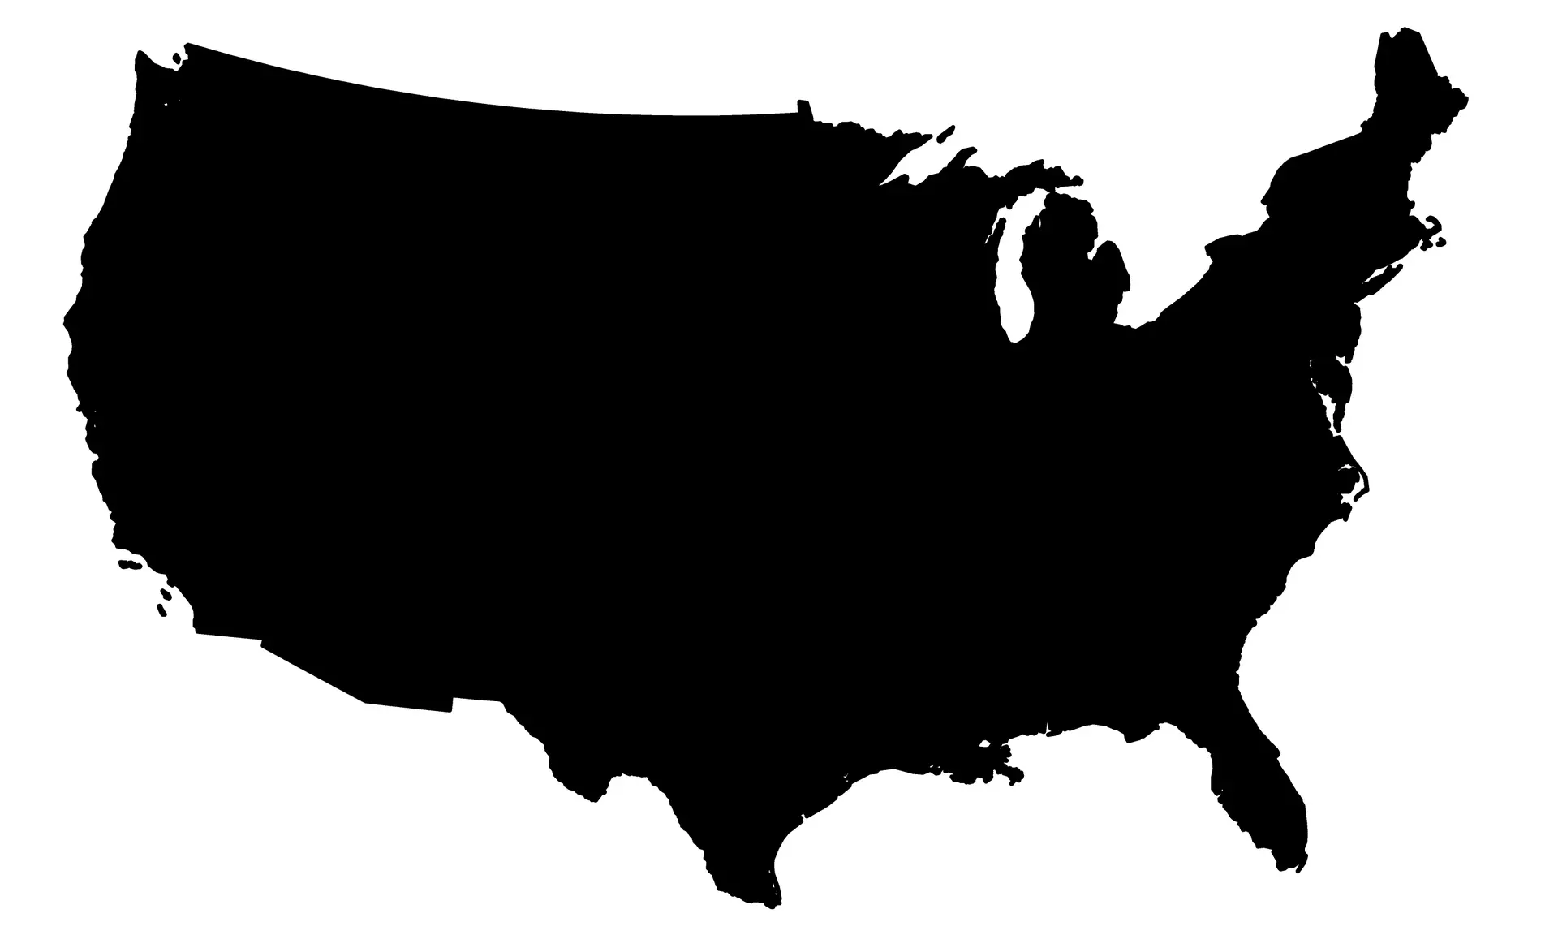
Map A

Slide 2
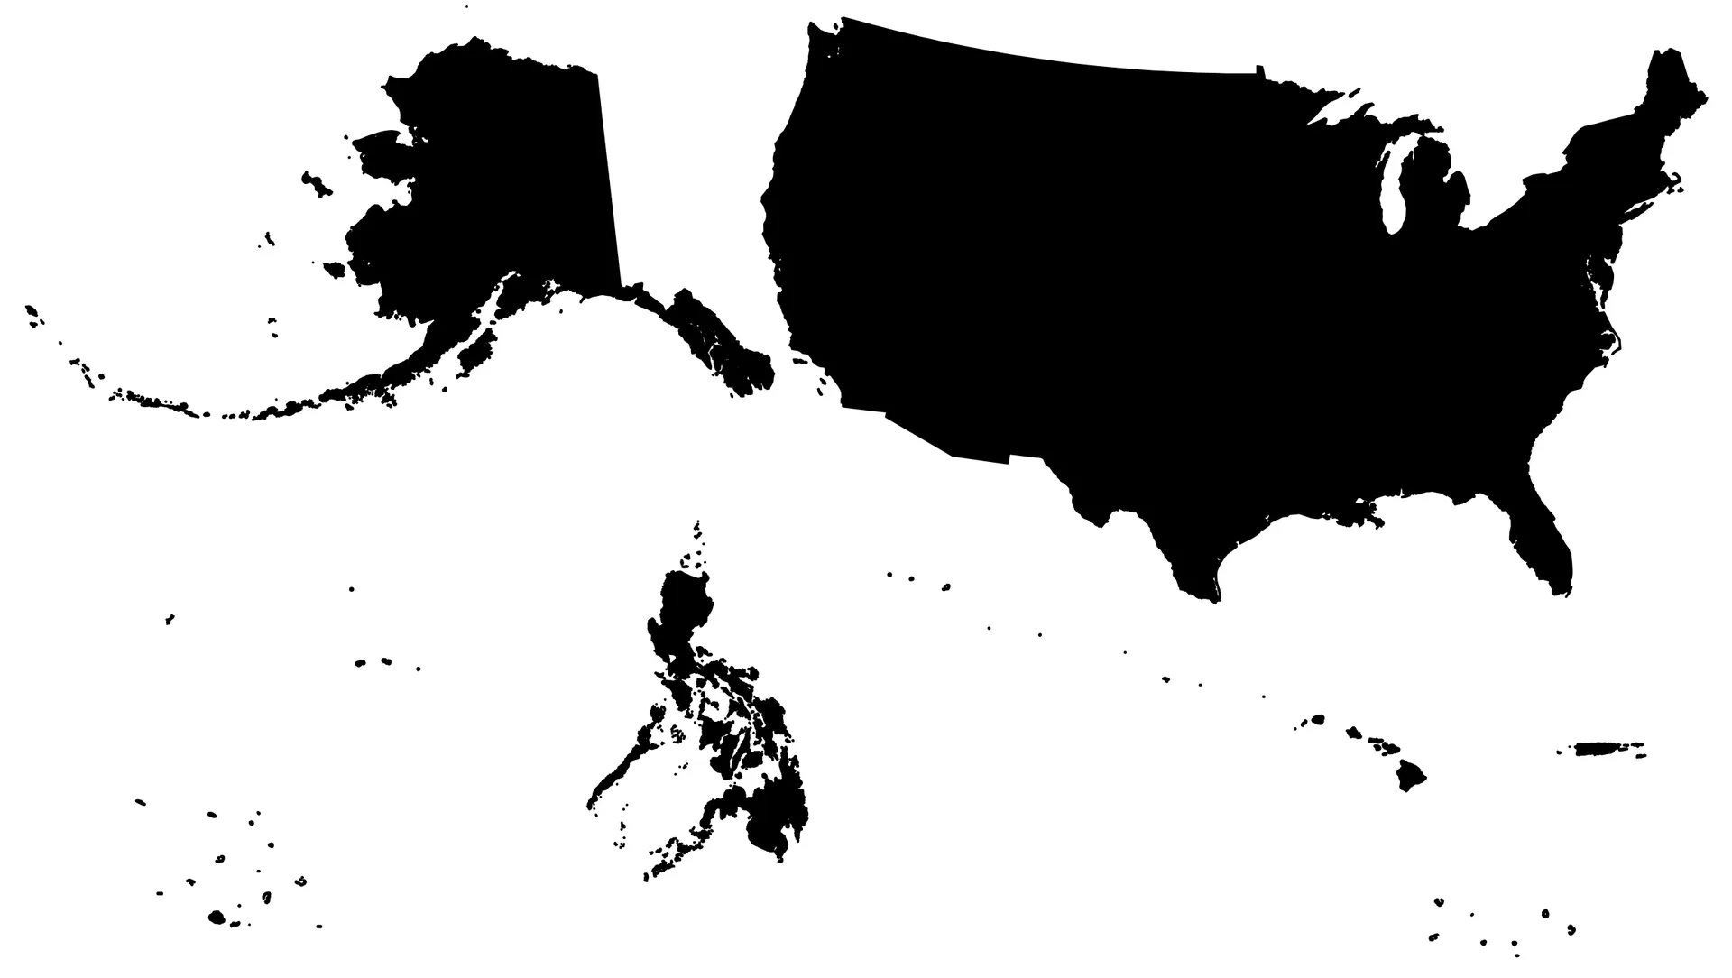
Map B

Slide 3
US Census (1940)
Mainland US Population: 131,669,275
Territory:
Philippines: 16,356,000
Puerto Rico: 1,869,255
Hawaii: 423,330
Alaska: 72,524
Panama Canal Zone: 51,827
US Virgin Islands: 24,889
Guam: 22,290
American Samoa: 12,908
Total in Territories: 18,833,023 (12.6 percent of the US didn’t live on the mainland)

Slide 4
Top 10 US Cities by Population (1940)
New York- 7.4 million
Chicago- 3.9 million
Philadelphia- 1.9 million
Detroit- 1.6 million
Los Angeles- 1.5 million
Cleveland- 878,336
Baltimore- 859,100
St. Louis- 816,048
Boston- 770,816
Manila- 684,000

