Slide 1
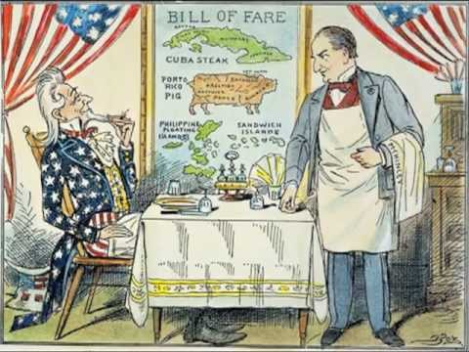

Slide 2
Analysis
What does the waiter represent?
What does the customer represent?
What does the menu represent?
What is the cartoonist trying to say?
Is the cartoonist pro or anti-imperialism? Defend your answer.

Slide 4
Imperialism
What are the negatives of Imperialism
What are the positives of imperialism?

