Slide 1
Urbanization
America Grows Out and Up

Slide 2
The Changing America

Slide 3
Skyscraper/Mass Transit

Slide 4
Slums/Tenements

Slide 5
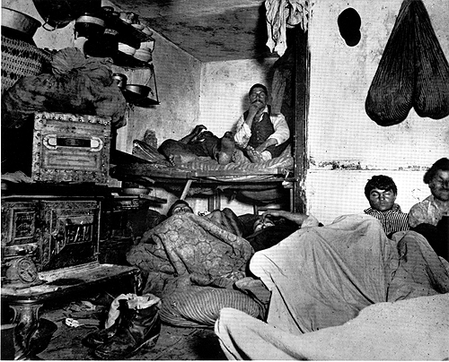
Tenements

Slide 6
Jane Addams

Slide 7
Settlement Houses

Slide 8
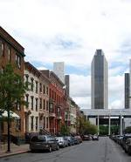
Row Houses

Slide 9
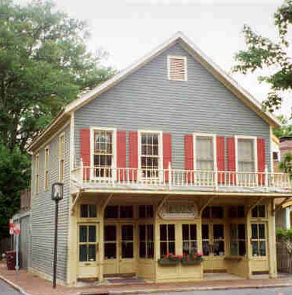
Middle Class Living

Slide 10
Wealthy Suburbs

Slide 11
Department Stores

Slide 12
City Beautiful Movement

Slide 13
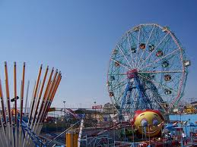
Americans Love Entertainment

Slide 14
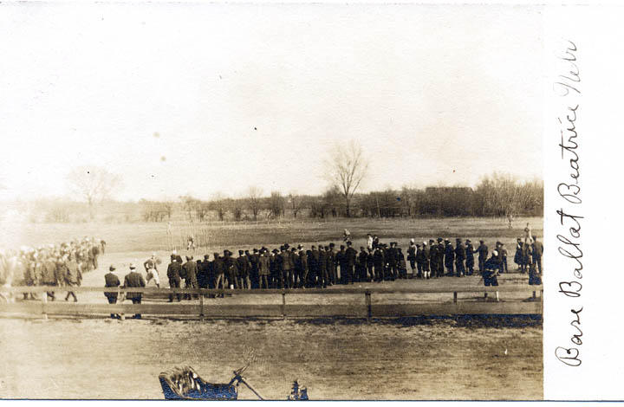
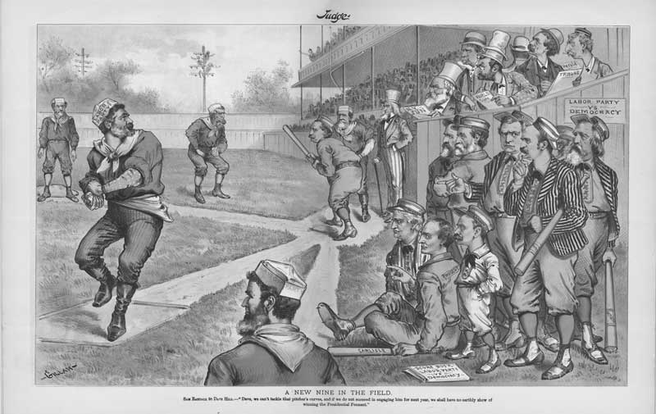
Baseball

Slide 15
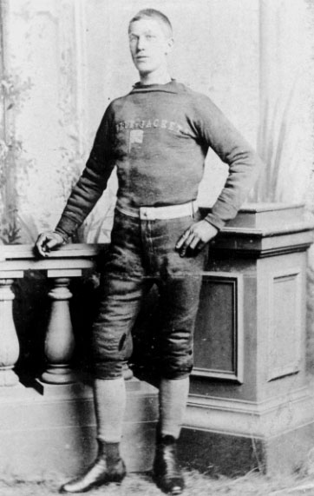
Football

Slide 16
Basketball

Slide 17
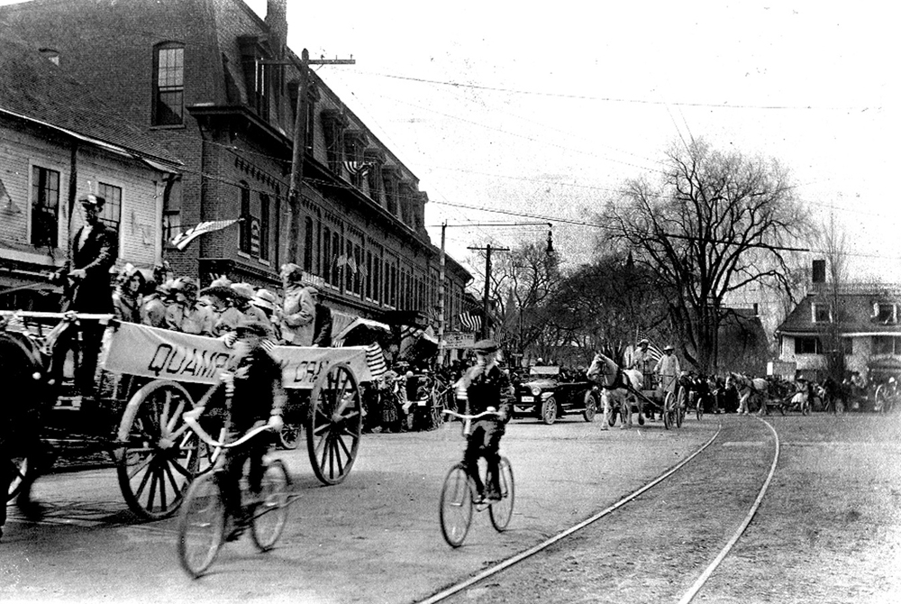
Bicycling

Slide 18
Tennis

Slide 19
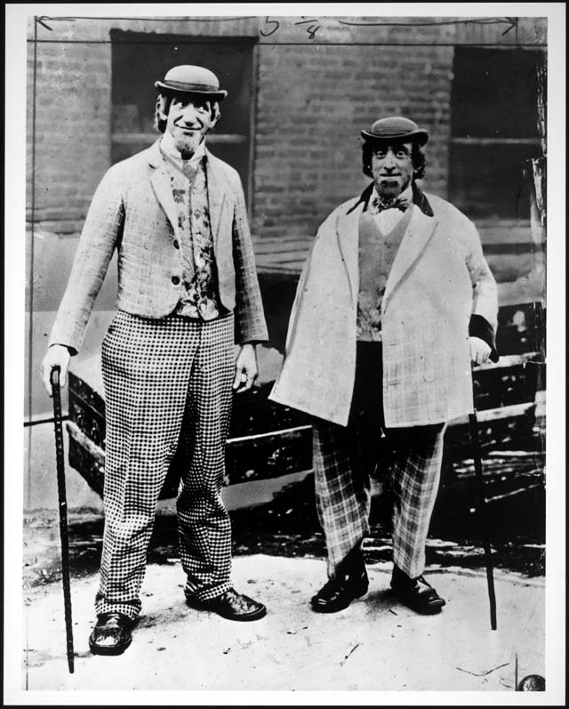
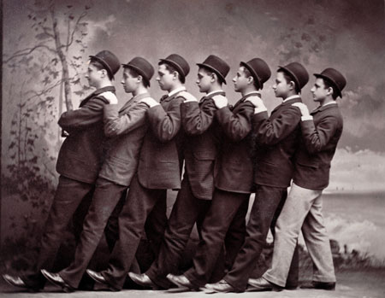
Vaudeville

Slide 20
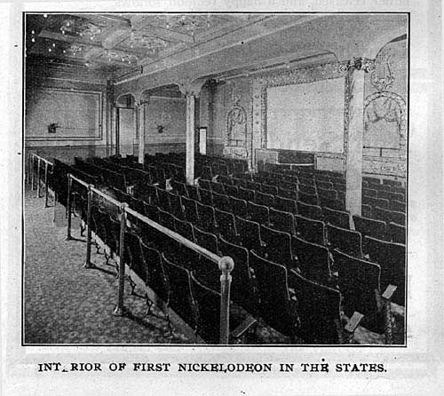
Nickelodeons

Slide 21
Immigrant Diary Entry
Write a 1 page diary entry about your experiences as a new immigrant into the United States.
Incorporate 5 terms from Chapter 18 in your diary entry.
Underline the terms you use.
Cite 3 facts from the Ellis Island virtual tour.

Slide 22
Include the following in your entry 625-629 in the in-class book
Where did you come from?
Why did you come to the U.S.?
How did you get to the U.S.?
What was required before you were allowed into the U.S.
Where did you find work once in the U.S.?
Where did you live once you arrived in the U.S.?
What were some obstacles in your life as a new immigrant?

